Slide 1



Smart Irrigation System for Efficient Agriculture
Linkedin: PRAKHAR SHARMA
Github link: github project link
Name:PRAKHAR SHARMA
Mentor Name:Raghunandan M

Slide 2

Learning Objectives: Objectives
GOAL: To engineer a comprehensive, professional-grade Smart Irrigation Dashboard that not only automates watering but also empowers farmers with actionable, real-time insights through live weather integration, system health monitoring, and multi-modal control.
To gain hands-on experience in data preprocessing and EDA of sensor data.
To build and train a multi-output classification model using Python's scikit-learn library.
To deploy a machine learning model into a feature-rich, interactive web application using Streamlit.
To integrate third-party APIs for live data feeds and implement security best practices using secrets management.
GOAL
Source :
www.freepik.com/

Slide 3
Tools and Technology use
Python Libraries:
Pandas: For efficient data manipulation and analysis.
Scikit-learn: For machine learning functionalities and loading the model with Joblib.
Matplotlib & Seaborn: For initial data visualizations and plots.
Requests: For making HTTP requests to external APIs.
Plotly: For creating interactive charts in the final application.
Streamlit:
For building the interactive web application and dashboard.
IDE/Environment:
Google Colab: Used for developing, training, and evaluating the machine learning model, and for generating the .pkl file.
Local Terminal/Command Prompt: Used to run the Streamlit web application on a local machine.
APIs & Services:
OpenWeatherMap API: To fetch live weather data for intelligent decision-making.
GitHub: Used for hosting the project's source code and managing different versions.

Slide 4
Methodology
The project is built upon a :
MultiOutputClassifier wrapping a RandomForestClassifier.
This model is trained on sensor data to predict the ON/OFF status for three farm parcels.
The model is saved as a
.pkl file for deployment.
Application Architecture:
A sophisticated multi-page application was developed using Streamlit's tabbed layout for a clean user experience (Dashboard, Analytics, System Health, Settings).
Application state (like the current irrigation mode) is managed across user interactions using st.session_state.
API keys and sensitive data are securely managed using Streamlit's secrets management, preventing exposure in the source code.

Slide 5
Methodology
Feature Integration:
Live Weather: Integrates the OpenWeatherMap API to fetch and display real-time temperature, humidity, and rain forecasts, providing crucial context.
Multi-Modal Control: Implemented logic for three distinct operational modes:
Automatic: AI-driven predictions.
Manual: Direct user control with override toggles.
Scheduled: Time-based irrigation set by the user.
System Diagnostics: A sensor health algorithm checks for abnormal readings (e.g., values at 0.0 or 1.0) and flags them for user attention.

Slide 6
Problem Statement:
POverview:
TThe Challenge: Modern farming requires more than simple automation. Farmers face a complex set of challenges including water scarcity, unpredictable weather, and a lack of trust in "black box" automated systems. There is a critical need for an intelligent system that is not only efficient but also transparent, controllable, and context-aware.
PProblem Statement:
TTo address this gap by developing an integrated dashboard that provides intelligent AI suggestions, full manual control, and vital real-time data (like weather and sensor health), fostering trust and empowering the farmer to make optimal decisions.

Slide 7
Solution:
The "Agri-Smart Pro" Dashboard: A comprehensive, multi-faceted solution was developed to tackle the challenges of modern irrigation.
Intelligent Dashboard: Displays AI-powered predictions alongside live weather metrics, offering a holistic view for decision-making.
Total User Control: Features three operational modes (AI, Manual, Scheduled) and allows for immediate manual override of individual sprinklers.
Deep Analytics:Provides interactive charts for current sensor data, historical water usage trends, and a detailed event log for auditing every action.
System Diagnostics: A dedicated "System Health" tab actively monitors all 20 sensors and flags potential malfunctions, enabling proactive maintenance.
Customization & Security: Includes tailored advice based on selected crop profiles and ensures secure API key handling via Streamlit Secrets.
GitHub Link: Click here for the github link.
API KEY: 02073b5867c5940938ee3b84954e47d7
Click here if the code does not visible.It has drive link for every file related to this internship.

Slide 8
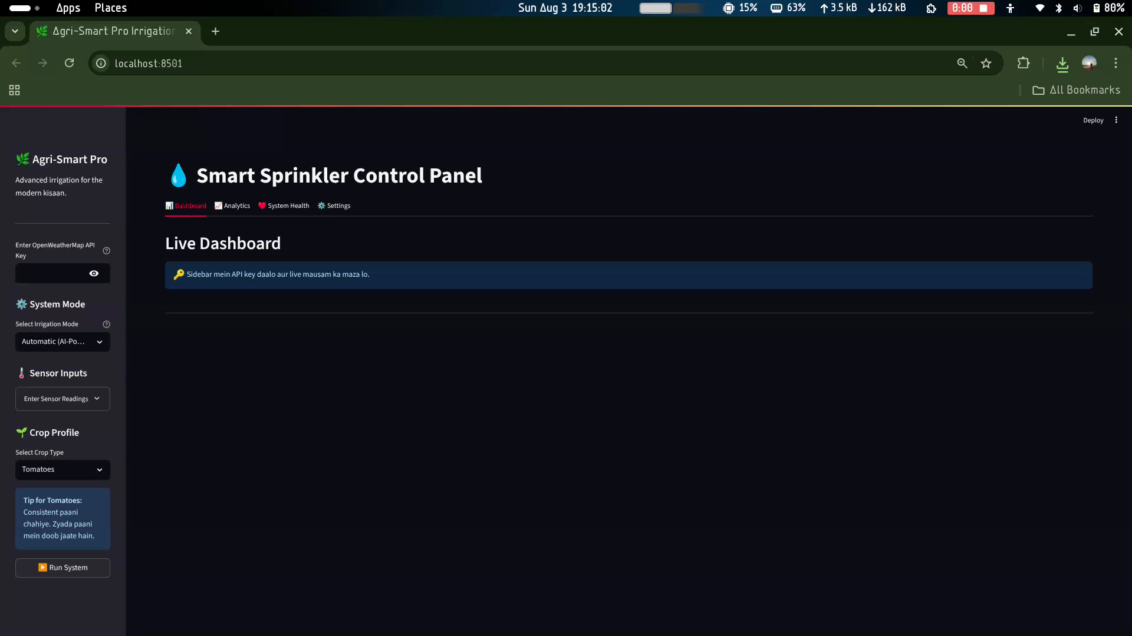
Local URL: http://localhost:8501 Network URL: http://192.168.1.40:8501
Screenshot of Output:
This is a video
Of the output.
I had to add it because my project had multiple features.
Pl note that the API key is:
02073b5867c5940938ee3b84954e47d7

Slide 9
CONCLUSION: This project successfully evolved from a simple proof-of-concept into a robust prototype for a comprehensive farm management dashboard. By integrating a machine learning model with live APIs, advanced user controls, and system diagnostics, it demonstrates a clear path toward building practical, trustworthy, and highly efficient agricultural technology.
Future Scope:
Predictive Maintenance: Utilize historical sensor data to train a model that predicts sensor failures before they occur.
Dynamic Cost-Benefit Analysis: Enhance the savings calculator to use real-time water prices and historical usage data for more accurate financial insights.
Automated Alerting System: Integrate email or SMS notifications to alert farmers of critical events, such as system malfunctions or irrigation cycles skipped due to rain.
Advanced Soil-Moisture Models: Incorporate more complex models that factor in soil type, evaporation rates, and crop growth stage for even finer control over water usage.

